Slide 1



X
Kalbe Product Sales
Project Based Intern
Presented by
Gidion Buranda

Slide 2


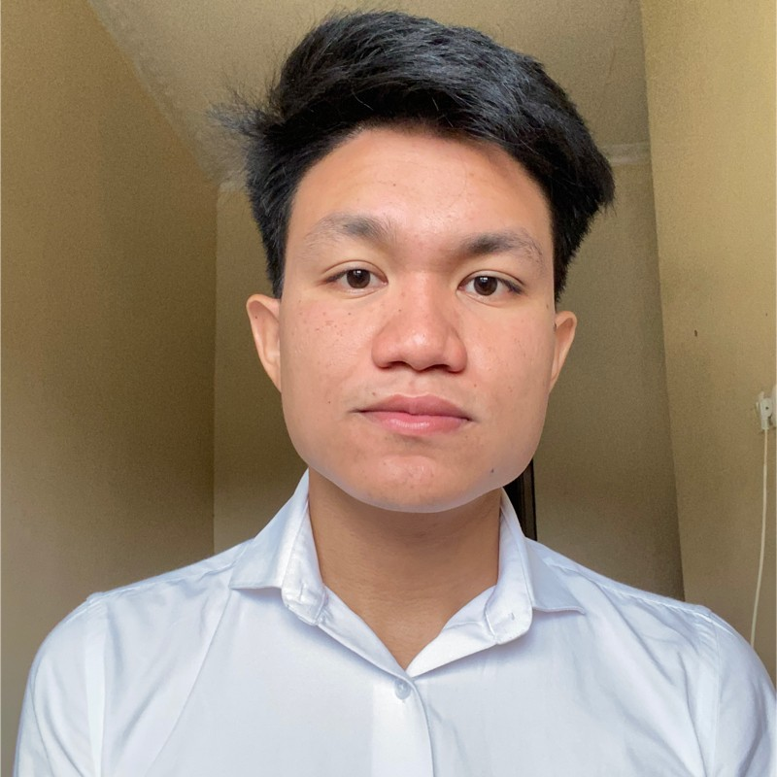
Gidion Buranda
Insert Your Experience
Data Scientist Intern (Aug 2023)
Qarir Generator
About Me
Project Based Intern by Forage
Quantium (July 2023)
Accenture (June 2023)
British Airways (May 2023)
I'm a passionate Data Enthusiast specializing in Data Analytics, Machine Learning, and Deep Learning. My skills include Python, SQL, Google BigQuery, Tableau, and Google Data Studio. I have experience in deep learning, statistics, data mining, analysis, and forecasting.
Study Independen –Startup Campus
Data Science Track ( Aug – Dec 2022)

Slide 3


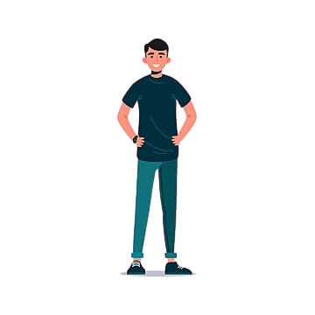

Insight
Age Average
Single
30 years old
Married
43 years old
Men
40 years old
Women
40 years old

Slide 4


Insight
Prisma Utama is the store with the highest total quantity.
Choco bar the best-selling product name with the highest total amount.

Slide 5
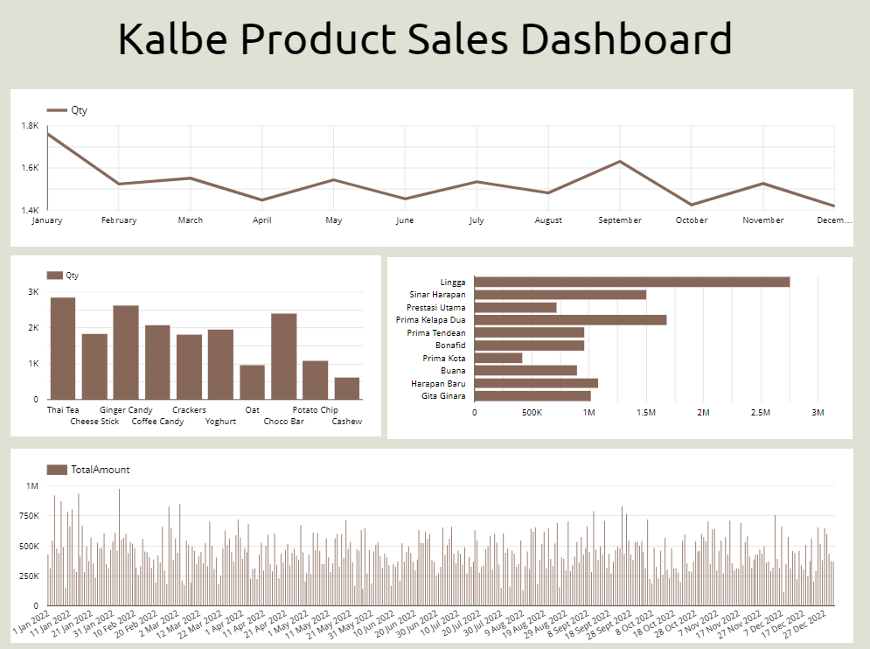

Slide 6
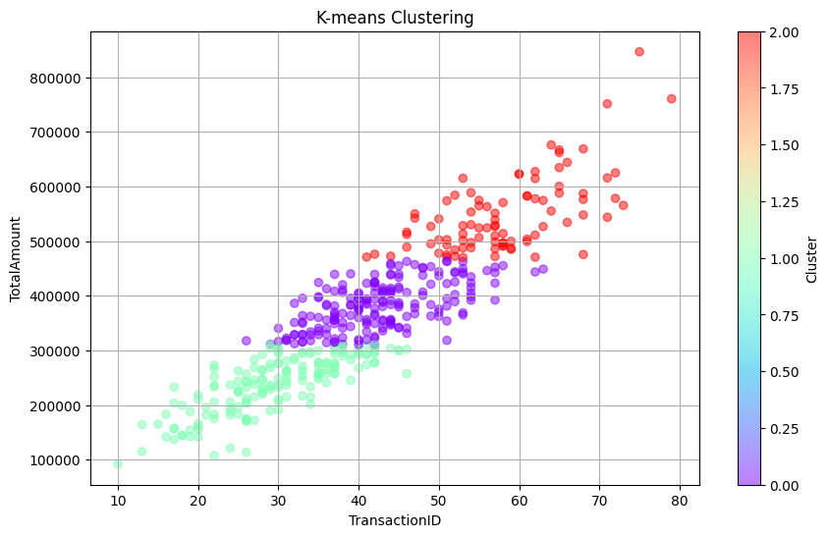
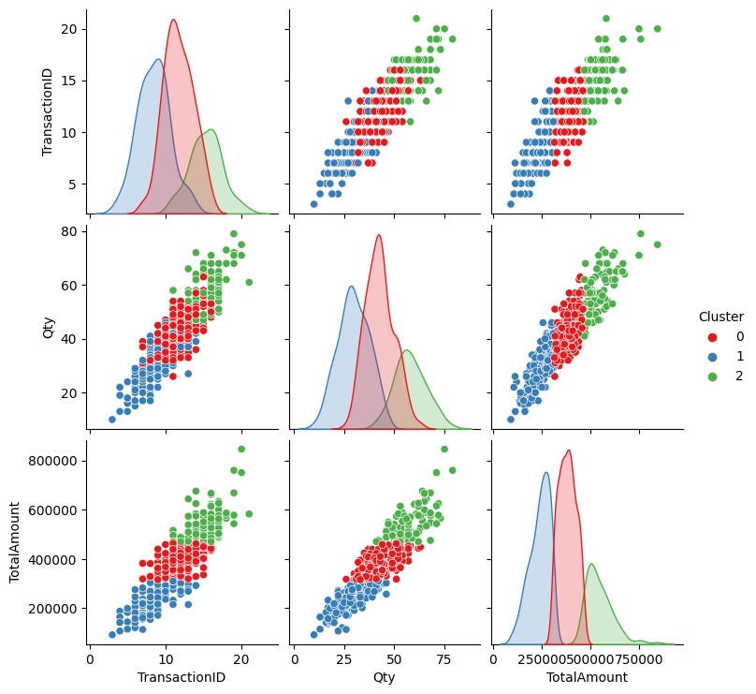
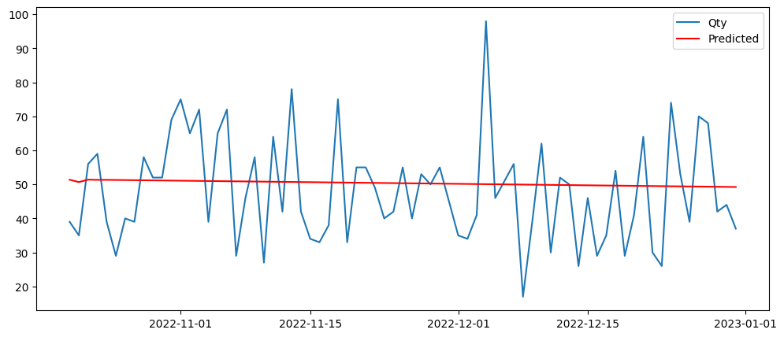
Reggresion and Clustering
Machine Learning using reggresion and kmeans clustering

Slide 7
Conclusion
Theres 3 type of consument,
A small portion of all the customers are in cluster 0
Most of Customer are Cluster 1
The second-largest group of customers is in Cluster 2
Cluster 0 customers are those who have an average quantity and total amount of purchases. Cluster 1 customers are those who still spend a little and make small purchases.
Cluster 2 customers are those who buy a large quantity and spend a significant amount of money.

Slide 8
Recommendation
Cluster 0: Customer interest development survey, in order to become loyal customers.
Cluster 1: Discounts to increase quantity and transactions.
Cluster 2: Loyalty promotions to retain these customers.

Slide 9
Colab : https://colab.research.google.com/drive/1vpLV9_x0tJyQ9qPPSPQJyValNB-qsOiU?usp=sharing
Github : github.com/gidionburanda
Linkedin : linkedin.com/in/gidionburanda/

Slide 10
Video Presentation
https://drive.google.com/file/d/1xUuHp33piu1juCXZt7xVVz0vM2oQ4l3W/view?usp=drive_link

Slide 11
Thank You
X

